Slide 1

Logistic Regression

Slide 2
ML
Machine learning
Machine learning uses artificial intelligence to enable machines to learn and predict outcomes more accurately without being explicitly programmed to do so. This makes them more similar to humans. The machine learning models continuously learns and improves its performance with the use of necessary data.

Slide 3
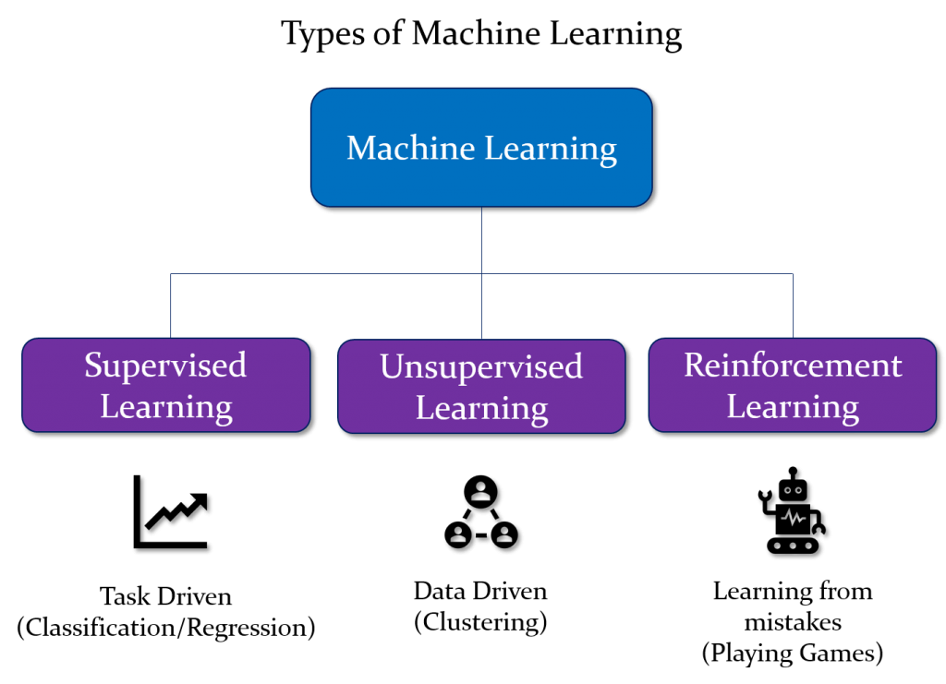

Slide 4
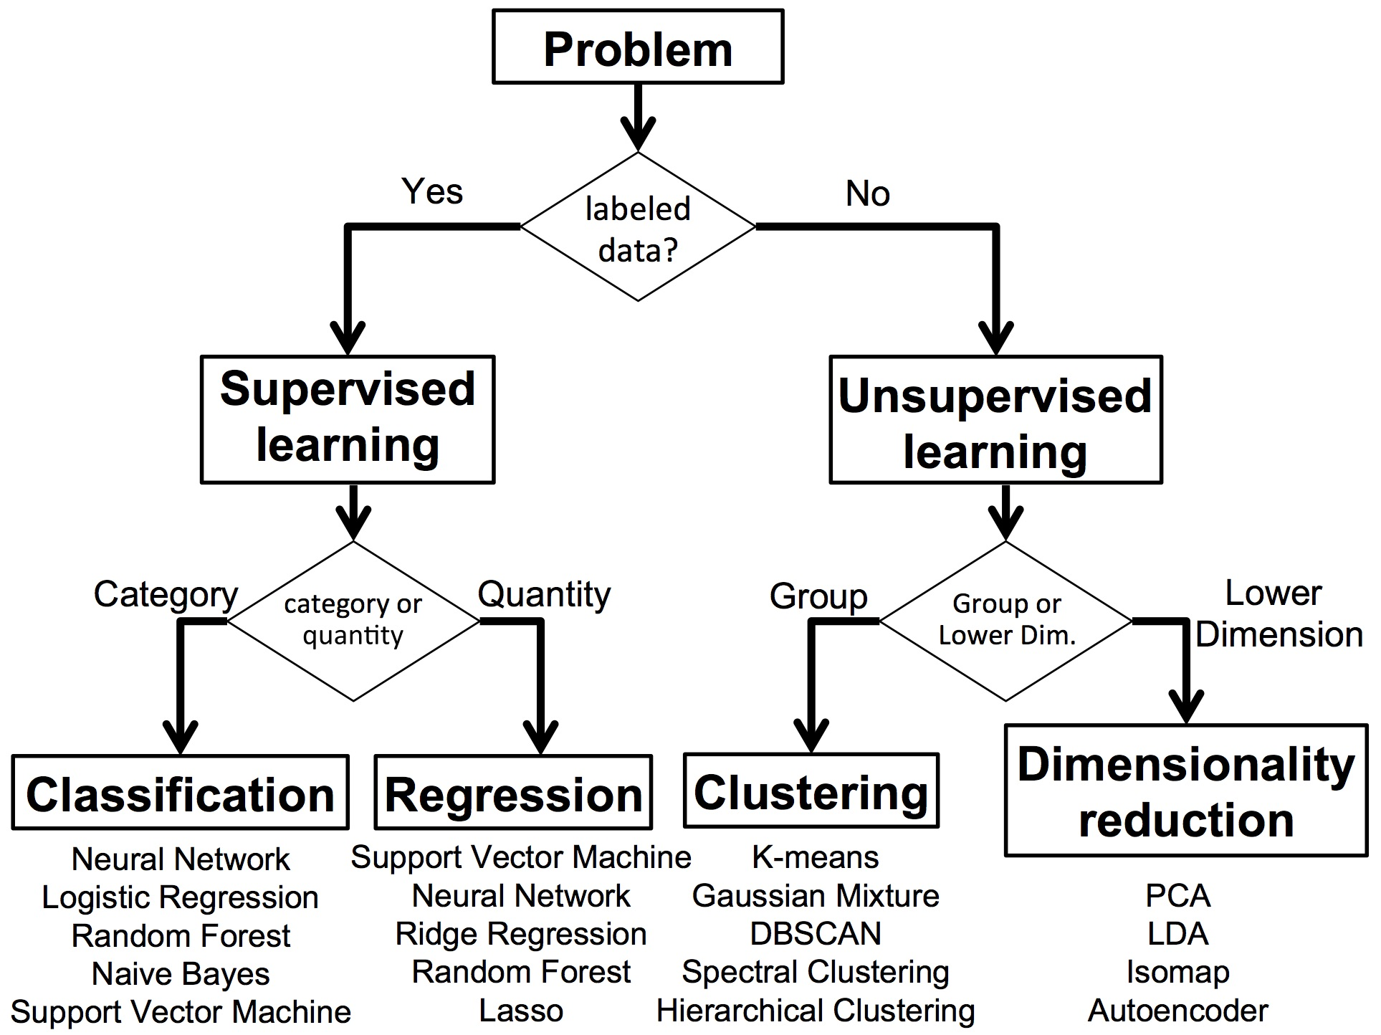

Slide 5
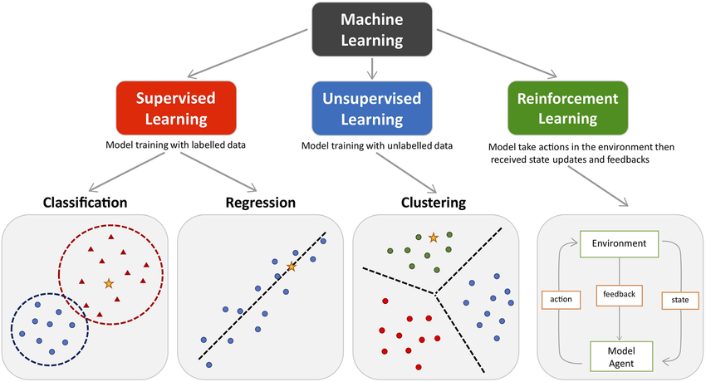

Slide 6
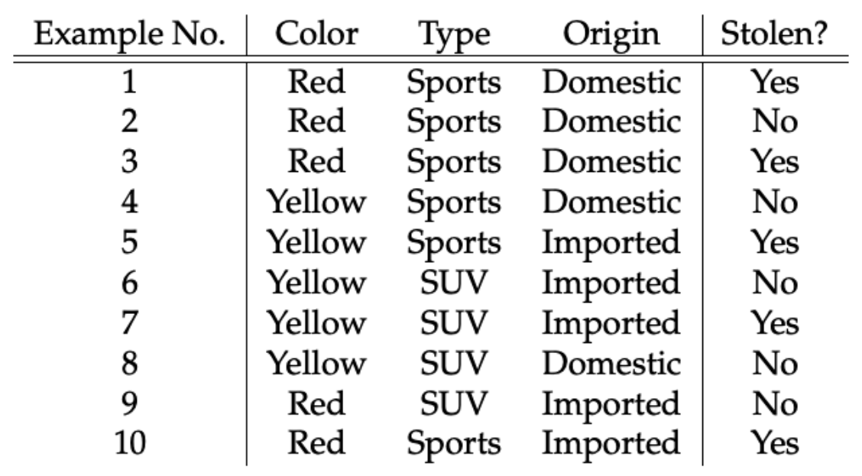
Tabular data to predict whether car is stolen or not?
Features
Label

Slide 7
Data
ML Algorithm
ML Model

Slide 8
Steps in ML
1. Data collection
2. Data preparation
3. Choose a ML model
4. Train the model
5. Evaluate the model
7. Make predictions
6. Parameter tuning

Slide 9
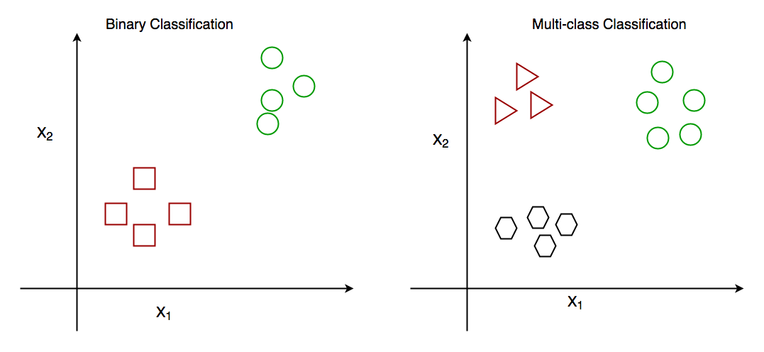
Classification: Classification algorithms are used to predict a categorical output. For example, a classification algorithm could be used to predict whether an email is spam or not.
Classification Types
There are two main classification types in machine learning:
Binary Classification
Multiclass Classification
Classification Algorithms
There are various types of classifiers algorithms. Some of them are :
Linear Classifiers
Non-Linear Classifiers
https://www.geeksforgeeks.org/getting-started-with-classification/

Slide 10
Linear Classifiers
Linear models create a linear decision boundary between classes. They are simple and computationally efficient. Some of the linear classification models are as follows:
Logistic Regression
Support Vector Machines having kernel = ‘linear’
Single-layer Perceptron
Stochastic Gradient Descent (SGD) Classifier
Non-linear Classifiers
Non-linear models create a non-linear decision boundary between classes. They can capture more complex relationships between the input features and the target variable. Some of the non-linear classification models are as follows:
K-Nearest Neighbours
Kernel SVM
Naive Bayes
Decision Tree Classification
Ensemble learning classifiers:
Random Forests,
AdaBoost,
Bagging Classifier,
Voting Classifier,
Multi-layer Artificial Neural Networks

Slide 11
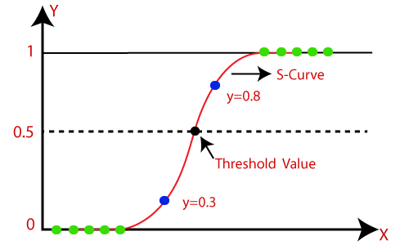
Logistic Regression
Introduction to Logistic Regression
Sigmoid Function
Confusion Matrix
Classification Evaluation Metrics
Logistic regression predicts the output of a categorical dependent variable. Therefore the outcome must be a categorical or discrete value. It can be either Yes or No, 0 or 1, true or False, etc. but instead of giving the exact value as 0 and 1, it gives the probabilistic values which lie between 0 and 1.
Assumptions for Logistic Regression:
The dependent variable must be categorical in nature.
The independent variable should not have multi-collinearity.

Slide 12
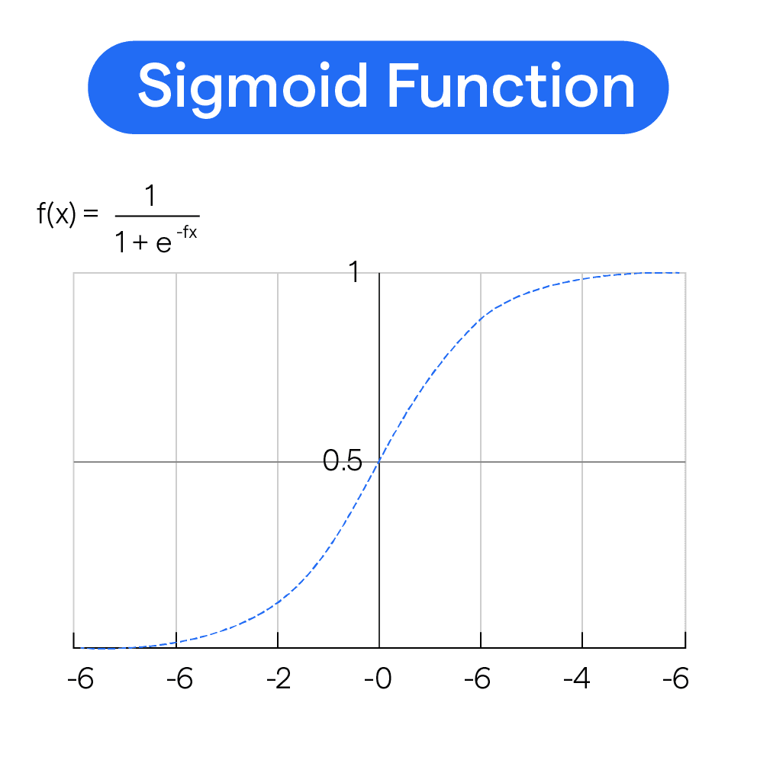
Logistic Function (Sigmoid Function):
The sigmoid function is a mathematical function used to map the predicted values to probabilities.
It maps any real value into another value within a range of 0 and 1.
The value of the logistic regression must be between 0 and 1, which cannot go beyond this limit, so it forms a curve like the "S" form. The S-form curve is called the Sigmoid function or the logistic function.
In logistic regression, we use the concept of the threshold value, which defines the probability of either 0 or 1. Such as values above the threshold value tends to 1, and a value below the threshold values tends to 0.

Slide 13
Type of Logistic Regression:
On the basis of the categories, Logistic Regression can be classified into three types:
Binomial: In binomial Logistic regression, there can be only two possible types of the dependent variables, such as 0 or 1, Pass or Fail, etc.
Multinomial: In multinomial Logistic regression, there can be 3 or more possible unordered types of the dependent variable, such as "cat", "dogs", or "sheep"
Ordinal: In ordinal Logistic regression, there can be 3 or more possible ordered types of dependent variables, such as "low", "Medium", or "High".
#Fitting Logistic Regression to the training set
from sklearn.linear_model import LogisticRegression
classifier= LogisticRegression(random_state=0)
classifier.fit(x_train, y_train)

Slide 14
Cost functions/loss function in logistic regression
Log loss
L1 (feature selection ,lasso)and L2(reduction overfitting ridge) regularization
C & lambda relationship
And lambda is hyper parameter

Slide 15
Classification Models in Machine Learning
Evaluating a classification model is an important step in machine learning, as it helps to assess the performance and generalization ability of the model on new, unseen data. There are several metrics and techniques that can be used to evaluate a classification model, depending on the specific problem and requirements. Here are some commonly used evaluation metrics:
Classification Accuracy: The proportion of correctly classified instances over the total number of instances in the test set. It is a simple and intuitive metric but can be misleading in imbalanced datasets where the majority class dominates the accuracy score.
Confusion matrix: A table that shows the number of true positives, true negatives, false positives, and false negatives for each class, which can be used to calculate various evaluation metrics.
Precision and Recall: Precision measures the proportion of true positives over the total number of predicted positives, while recall measures the proportion of true positives over the total number of actual positives. These metrics are useful in scenarios where one class is more important than the other, or when there is a trade-off between false positives and false negatives.
F1-Score: The harmonic mean of precision and recall, calculated as 2 x (precision x recall) / (precision + recall). It is a useful metric for imbalanced datasets where both precision and recall are important.
ROC curve and AUC: The Receiver Operating Characteristic (ROC) curve is a plot of the true positive rate (recall) against the false positive rate (1-specificity) for different threshold values of the classifier’s decision function. The Area Under the Curve (AUC) measures the overall performance of the classifier, with values ranging from 0.5 (random guessing) to 1 (perfect classification).
Cross-validation: A technique that divides the data into multiple folds and trains the model on each fold while testing on the others, to obtain a more robust estimate of the model’s performance.

Slide 16
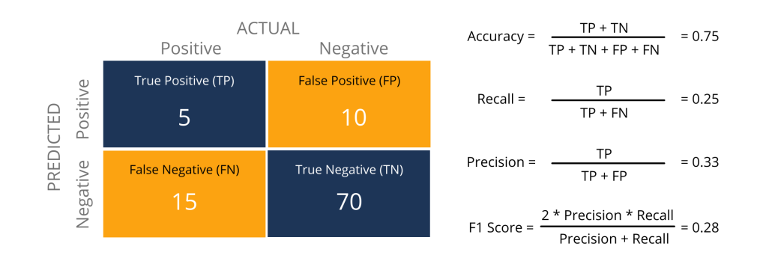
Metrics to Evaluate your Classification Model
https://www.analyticsvidhya.com/blog/2021/07/metrics-to-evaluate-your-classification-model-to-take-the-right-decisions/

Slide 17
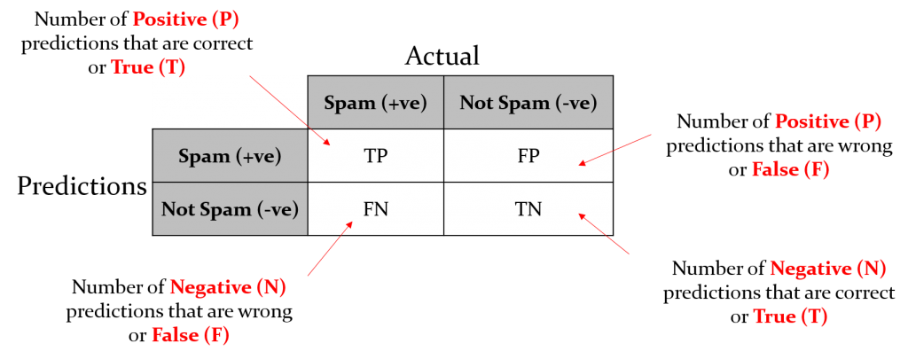
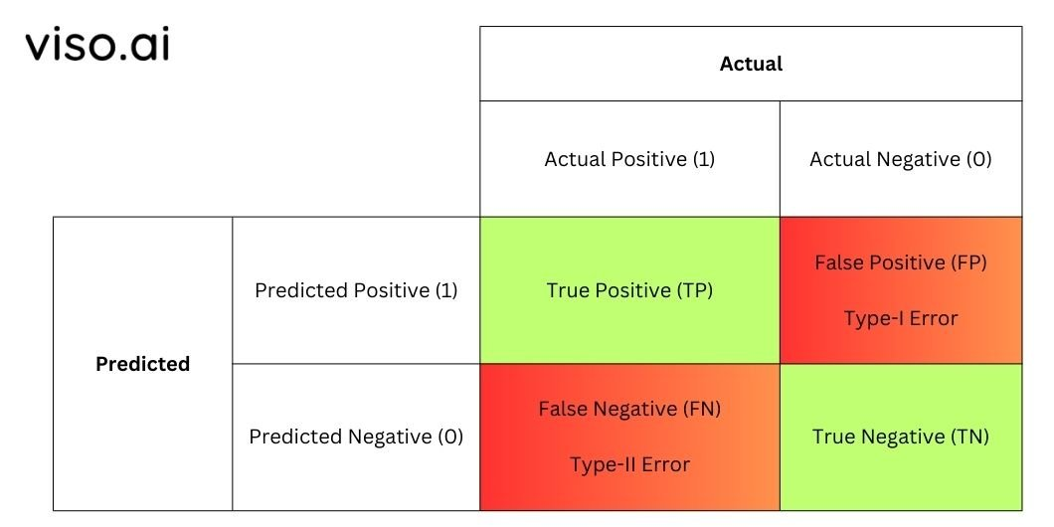
confusion-matrix-machine-learning
https://www.geeksforgeeks.org/confusion-matrix-machine-learning/

Slide 18
https://www.kaggle.com/code/prashant111/logistic-regression-classifier-tutorial
Implementations with all in one

